Slide 1
Made By: The Courageous Octopi
Apoorva Arun Magadi | Leadership and Management, Writing and Deliverables
Deirdre Lyons-Keefe | Leadership and Management, UX Design and Prototyping
Frankie Jean Herbert | Leadership and Management, User Research and Communication
Prototype Link: The Courageous Octopi Prototype Link

Slide 2
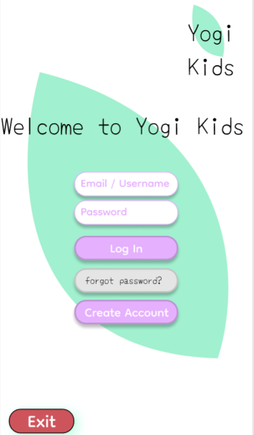
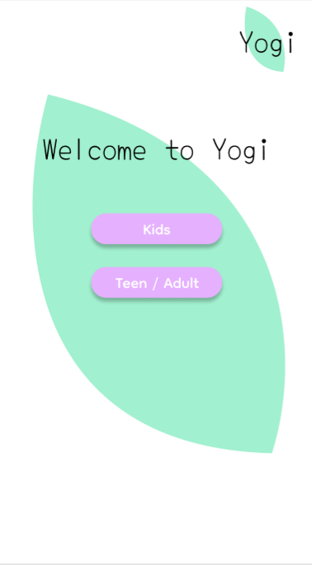
Welcome Page –
When users first open Yogi, they are presented with a warm Welcome Page in which provides them with 2 options based on age requirements. Yogi is designed for all age groups with appropriate settings that provide each user with the experience that best suits their needs. Yogi Kids is designed for age groups 10 and younger. Teen/Adults is designed for those that are 10+ based on app navigation capabilities.
User Research / Design Feedback:
As a group, we decided that presenting our users with a less complex Welcome Page, rather than an immediate Login Screen was appropriate. This addresses the issue of clustered design
Insights / Main Design Choices:
Create a Welcome Page to navigate each user towards a separate version of each Login Screen based on age specifications.
Friendlier design to minimize the visual concepts of the app.
Yogi's target audience includes members of all age groups. As a result, we include an age selection menu to deliver the best user experience. This aligns with Nielsen's Heuristic #5: error prevention.

Slide 3
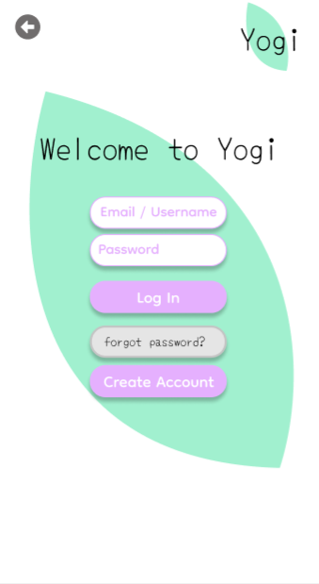
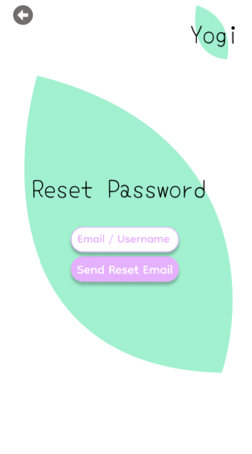
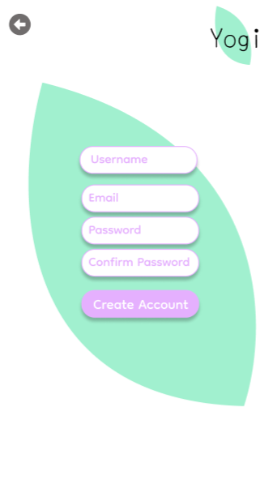
Login Page / Create Account –
Upon users input of either Kids or Teens/Adults, each will be directed towards Yogi’s Login Screen. Both Kids and Teens/Adults have very similar user interfaces in which is easy to navigate. The user can Login directly or Create an Account. The Login Page also provides each user with the selection for ‘Forget Password?’ in case this had been forgotten.
User Research / Design Feedback:
During heuristic evaluation, we realized we had no error handling present in the login screens. This was a clear violation of Usability Heuristic #9: Help users recognize, diagnose, and recover from errors.
Insights / Main Design Choices:
Once this heuristic violation was encountered by our experts, we added in two additional features: the ability to recover a forgotten password, and the error messaging that would appear if a user attempted to create a new account using an email already associated with an account.
For full effects of an application that provides users with the option to use only an email or a username, or both. Each Login Screen had implemented the ability to do so as well.

Slide 4
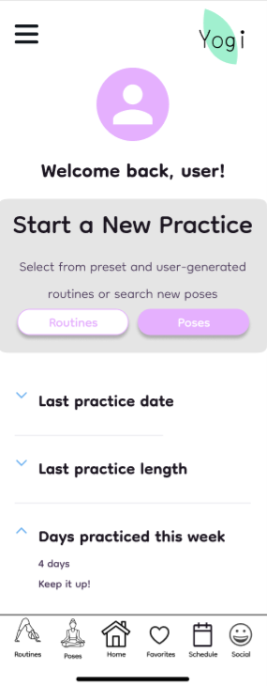
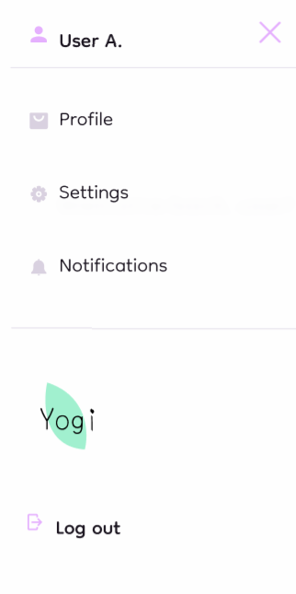
Home Page / Navigation –
Once the user has successfully logged into their Yogi accounts, each will be greeted with a ‘Welcome back, user!’ The Home Page is where each user will be able to start a practice. A footer has been included within each Screen and giving users the ability to navigate quickly through Yogi.
User Research / Design Feedback:
Users across different target audiences expressed that starting and sticking with an exercise routine was challenging.
We wanted to align with Nielsen's Heuristic #2: Match between system and the real world.
Insights / Main Design Choices:
As a result of our research, we decided to include motivational KPIs for users upon login. Users are presented with stats related to the last time they practiced, the duration of their last practice, along with the number of days they have practiced in the last week.
To improve usability and adoption we provide our users with a standard footer navigation and account menu, aligning with industry standards and boosting user confidence.
Like many Home menus, there is an option to review additional settings. Here, users will also be able to manage their Yogi account notifications, profile information and login activity.

Slide 5
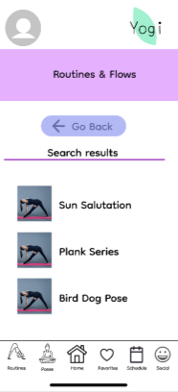
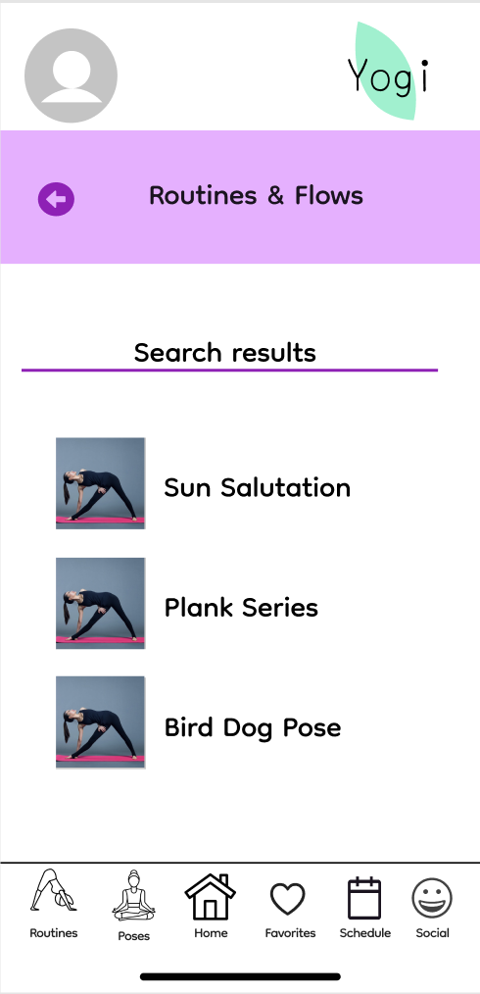
Routines and Flows Page –
Yogi presents a unified search experience for users, and most of these features can be found when searching for individual poses as well. We needed to find a way to help users digest and organize a lot of different Routines.
User Research / Design Feedback:
Users noticed inconsistencies in the way that we gave them the option to navigate back within the application. This violated Nielsen Heuristic #4, Consistency and Standards.
Users indicated they were overall satisfied with the way that the information was divided and presented.
Insights / Main Design Choices:
As a result, we replaced the Go Back buttons that were used in the Routines & Flows as well as Poses & Exercises sections of the application.
This provides uniform design aesthetics and user experience across all screens within the app.
Original
Update

Slide 6
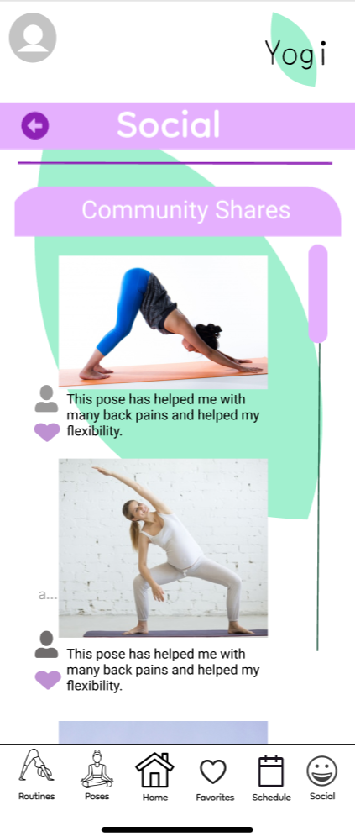
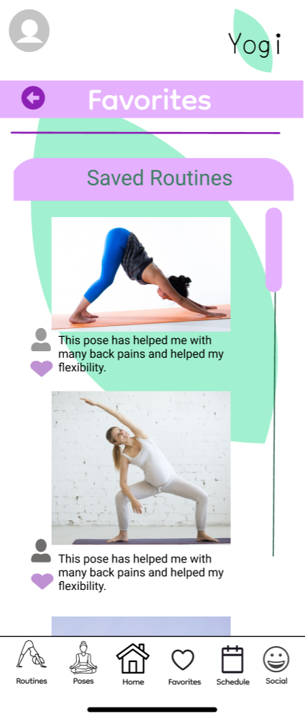
Social Page -
Having a Community of Shares helps inspire other users and introduces many to Routines that could benefit their needs as well. Social is designed to allow users to share their thoughts and routines to others. Once a Routine in Social is liked by hitting the ‘heart icon’ this sends the Routine into their ‘Favorites Category’ and allows users to save these special Routines.
User Research / Design Feedback:
View Social Feed screen, which include arrows indicating a back option is available, but that are not clickable
User had experienced issues using the ‘heart icon’ in order to save routines to their favorites page.
Insights / Main Design Choices:
‘Heart Icon’ has been corrected to allow the user to save the routines desired to their favorites page.
The back button has been updated so that the user can freely move between screens and visually see the concept idea.

Slide 7
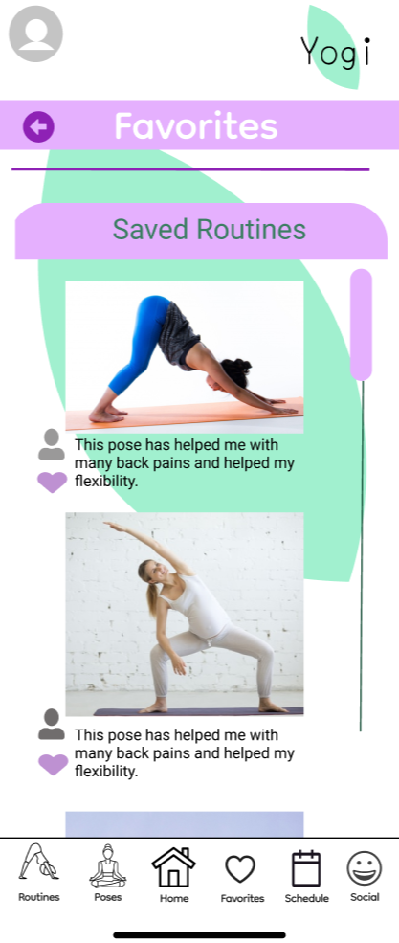
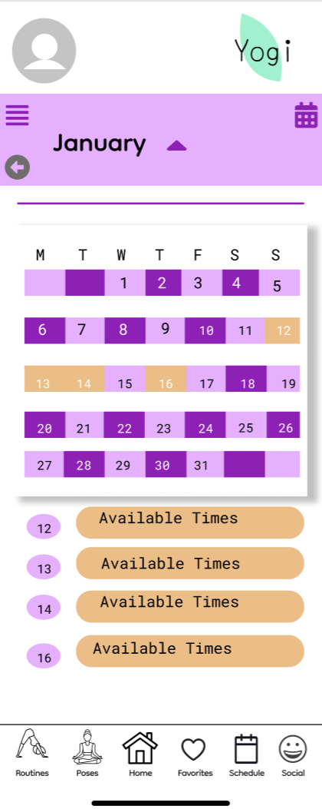
Favorites Page -
Favorites Page provides users with their saved Routines when searching or scrolling through Social. Once a Routine has been selected to place into the users' daily activities, the ‘heart icon’ is selected in which directs the user to a Calendar Page. The users are given highlighted days in which those routines would fit their daily schedule. This provides users with the ability to see when a routine can be practiced.
User Research / Design Feedback:
User has experienced issues with being able to go back from Calendar to favorites in order to add a new routine to their daily schedule.
The scroll feature was providing users difficulty to be able to scroll through their saved routines.
Visibility of system status, and the inability to meaningfully schedule a routine on the Calendar page, which violates heuristic 4
Insights / Main Design Choices:
If the user would like to add more, they are given a back button directing them to the favorites page to be able to do so or to choose the favorites selection in the sidebar at the bottom.
Calendar was updated to be able to go from Favorites and add the routine into the Calendar.

Slide 8
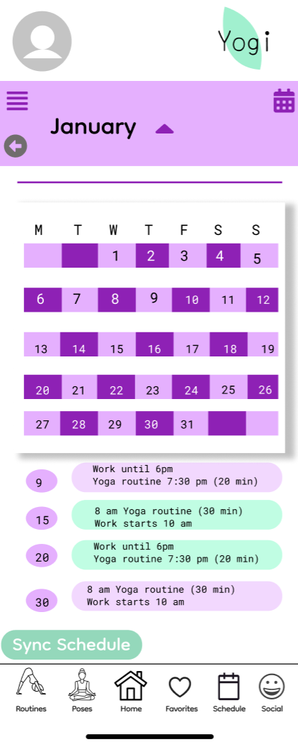
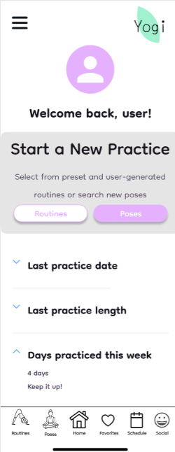
Calendar Page -
Calendar Page is a great way for users to be able to sync their personal schedules from their devices into Yogi. This enables users to analyze their personal schedules and see when a routine could fit into their daily lives.
User Research / Design Feedback:
User had issues with the sync schedule button at the bottom of the screen.
User had difficulties using the back button in the Calendar.
Insights / Main Design Choices:
The Calendar’s back button has been updated for easier navigation of Yogi. This sends the users back to the Main Home Page.
As the Sync Schedule button does not actually do anything for this prototype. The concept was left for the purposes of articulating a real-world application, with the meaning of what Yogi could do for each user in automatically Syncing their personal Schedules from their devices to properly form a routine around their personal Calendar.

Slide 9
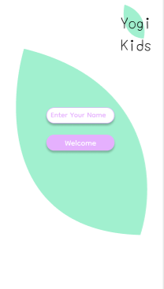
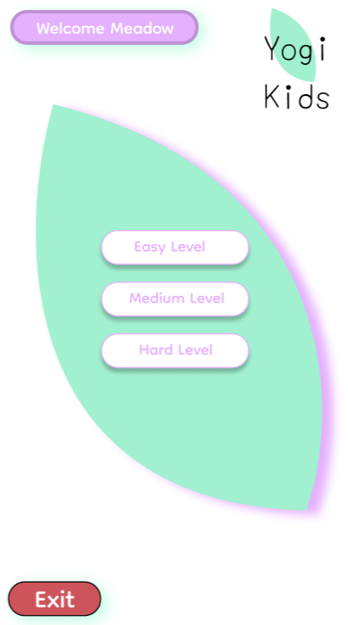
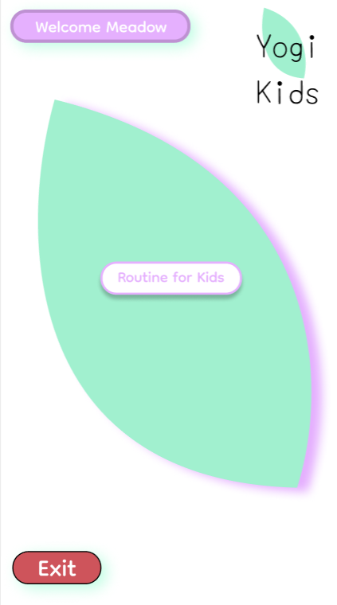
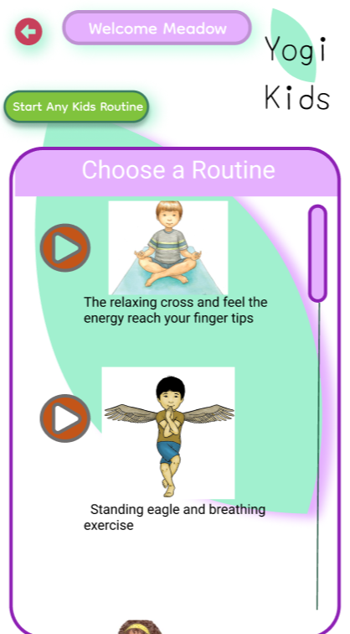
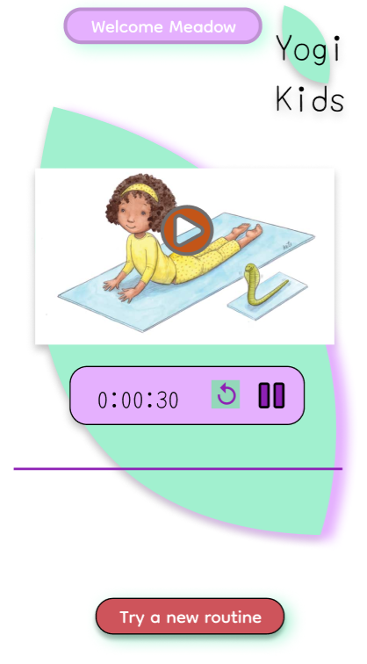
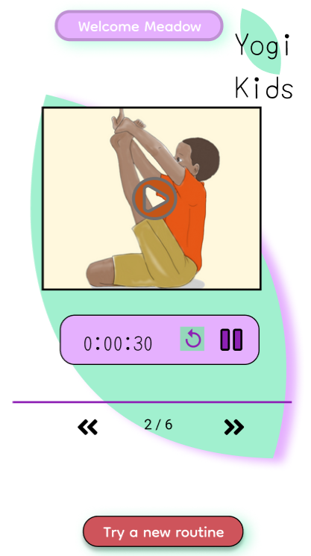
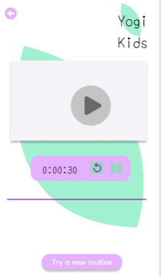
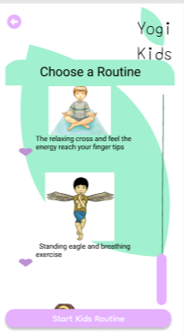
Original version
Yogi Kids -
Yogi Kids provides a simple version of Yogi in which allows younger children to be able to explore the yoga routines. Here younger children are provided with a Home Page with a selection ‘Routine for Kids’. Upon this selection, Yogi kids will be directed to a level difficulty of routines. By providing younger children with the capability of choosing their own level, more children will be able to enhance their abilities in practicing yoga while providing a wide range of routines as they grow. Once the level of difficulty has been selected, Yogi kids are then given a ‘Search Page’ in which allows them to do two things. Users have been provided with a pre-set search page to scroll through and find what fits them best. In the upper left-hand corner, there is a bright green button ‘Start Any Kids Routine’, for this selection there is a pre-set routine that will keep going after one video is done playing. This allows younger users to be able to keep going without stopping to search for a routine if there is not a specific one of interest.
User Research / Design Feedback:
Other high severity issues included the inability to navigate to the Yogi Kids application from the main Yogi login screen, which violates heuristic 1
the user was asked to exit out of Yogi Kids. This was not a task that was completed and had created a bit of frustration due to reading age not being able to identify the word ‘Exit’ for exiting.
The young participant was unable to exit out of a routine that was started, due to there not being a distinct way to tell.
Insights / Main Design Choices:
This has been updated by implementing a main login page where users can automatically select from Kids or Teen/Adults. When selecting on Kids, the user will be directed straight to Yogi Kids.
The exit button was updated to a ‘red button’ in which most kids acknowledge as an exit sign in their everyday lives. This has made it more visible in indicating where to exit Yogi Kids.
Yogi Kids was updated in providing a ‘red button’ for ‘Try a new routine’ which provides the user with the red button selection which is identified as exiting out of a selection as well.
Updated
version
Updated
version
Original version
Updated
version
Original version

Slide 10
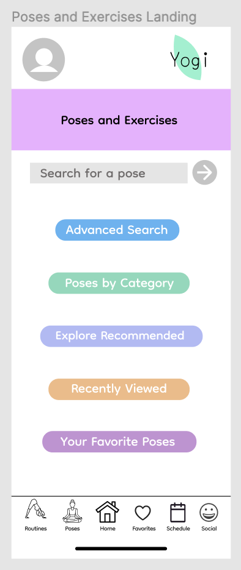
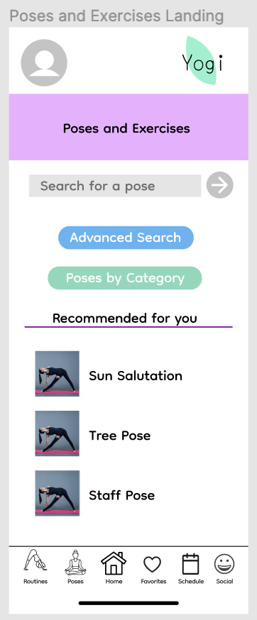
Poses and Exercises Landing Page -
This page provides the user with a starting point from which to find the poses they want, how they want. The user is provided with button options to select the way they want to look for a pose.
User Research / Design Feedback:
Users expressed that their skill level affected the search option they would choose.
Users expressed that there was too much to look at in the original page design, violating the Aesthetic and Minimalist Design heuristic
Insights / Main Design Choices:
Providing multiple ways of searching since search method varies by skill level
Organized the sections of the page using more buttons so that the user only has to look at features that they want to see, when they click on the button, and are not bombarded with too much information when they first open the page
The updated page
The original page
Skill level effects preferred search method. Beginners would likely use categorical search since they are less likely to know the pose name to search in search bar

Slide 11
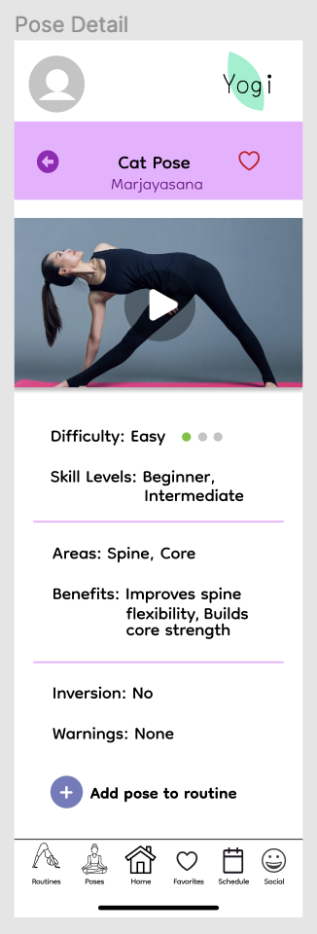
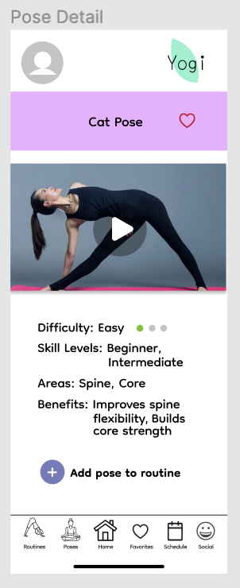
Pose Detail Page -
This page provides the user with information about a pose such as instructions on how to do a pose in a video, its difficulty level, the areas it targets, and any warnings that go with it. This page allows a user to favorite a pose by clicking on the heart icon by the pose name. The user can also add the pose to a routine.
User Research / Design Feedback:
Users expressed that they would like to see more pose information such as warnings about the pose and whether it is an inversion.
Users expressed that the original page looked too cluttered and the information was not organized in a way that was easy to digest. Also elements wiggled between pages.
Insights / Main Design Choices:
Included information about warnings and whether a pose in an inversion in the page since users expressed that they would like to see that in a yoga app they used
Increased spacing and organized sections of the information using lines. The textual information is now organized with difficulty and skill level info, areas and benefits info, and inversion and warning info grouped together. The coordinates of page elements have been made consistent so that there is no wiggling effect.
The original page
The updated page

Slide 12
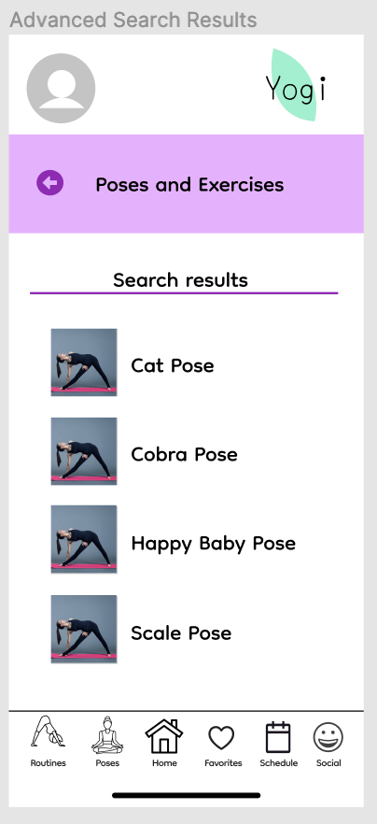
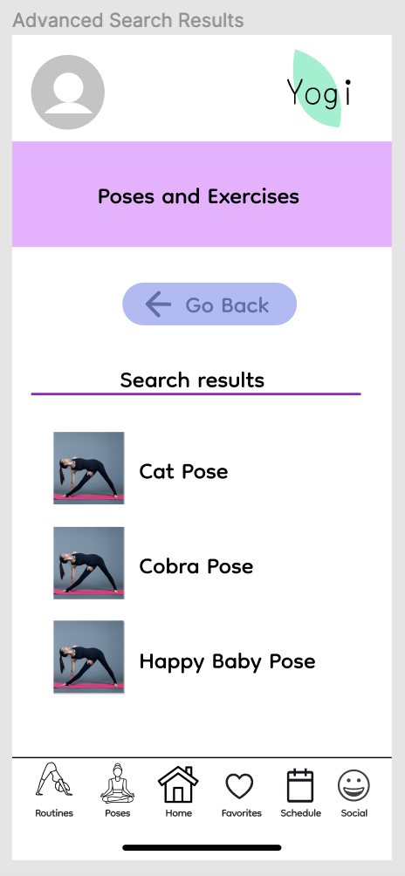
Poses and Exercises Advanced Search Results Page -
This page provides the user with the search results from the advanced search form. The poses in the search results can be clicked upon to be taken to the pose detail page for the particular pose.
User Research / Design Feedback:
During user testing, users expressed frustration with not being able to go to the pose detail page after clicking on the image by the pose name. The text of the pose name had to be clicked on instead.
Users gave reviews that the back button was not consistent throughout the app, violating the Consistency and Standards heuristic
Insights / Main Design Choices:
Images are clickable now – clicking on the image in the search results will also take you to the pose detail page.
Changed and moved the back button. The back button in the middle was large and required the user to look in the middle of the page for it, but it has been replaced by an arrow near the top left, which is easy to find and consistent with the rest of the app.
The updated page
The original page
Clicking an image takes you to the same page that clicking on the associated text does. This is the way many apps work and is intuitive for visual users.

